Slide 2
Chapter 9
THE BEHAVIOR OF SOLUTIONS
INTRODUCTION
At high enough temperature and low enough pressure the interactions among the atoms or molecules in mixtures of gases are small enough that they can be neglected, in which case the mixture can be considered to be a mixture of ideal gases. Consequently, at high temperature and low pressure, all mixtures of gases have the same thermodynamic mixing properties. In contrast, strong interactions exist between atoms, molecules, or ions in condensed solutions, and the nature and magnitudes of these interactions have a significant influence on the thermodynamic behavior of the solution. The interactions, which are determined by such factors as atomic size, electronegativity, and electron-to-atom ratio, determine the extent to which a component is soluble in a solution and whether or not two or more components can react chemically to form a separate species. Solution thermodynamics is concerned with the vapor pressure-temperature-composition relationships of the components of a solution, and an examination of solution thermodynamics is made in the chapter.
RAOULT’S LAW AND HENRY’S LAW
If a quantity of pure liquid A is placed in a closed, initially evacuated vessel at the temperature T, it will spontaneously evaporate until the pressure in the vessel reaches the
saturated vapor pressure of liquid A,
, at the temperature T. In this state a dynamic
equilibrium is established in which the rate of evaporation of liquid A equals the rate of condensation of A vapor. The rate of evaporation, r_{e(A)}, is determined by the magnitude of
the energy of the bonds between the atoms of A at the surface of the liquid. The forces exerted between the atoms are such that each surface atom is located near the bottom of a potential energy well, and for an atom to leave the surface of the liquid and enter the vapor phase, it must acquire an activation energy, E*. The intrinsic rate of evaporation, r_{e(A)}, is determined by the depth of the potential energy well, i.e., by the magnitude of E*,
and by the temperature T. On the other hand the rate of condensation, r_{c(A)}, is
proportional to the number of A atoms in the vapor phase which strike the surface of the liquid in unit time. For a given temperature, this is proportional to the pressure of the
vapor. Thus , and at equilibrium
(9.1)

Slide 3
The Behavior of Solutions 247
Eq. 9.1 illustrates why the saturated vapor pressures of liquids are exponential functions of temperature.* Similarly, when pure liquid B is placed in an initially evacuated vessel at the temperature T phase equilibrium between the liquid and its vapor occurs when
(9.2)
Consider the effect of the addition of a small quantity of liquid B to liquid A. If the mole fraction of A in the solution is X_{A} and the atomic diameters of A and B are similar, then,
assuming that the composition of the surface of the liquid is the same as that of the bulk liquid, the fraction of the surface sites occupied by A atoms is X_{A}. As A can only
evaporate from surface sites occupied by A atoms, the rate of evaporation of A is decreased by the factor X_{A}, and as, at equilibrium, the rates of evaporation and
condensation are equal to one another, the equilibrium vapor pressure of A exerted by the
A–B solution is decreased from , to p_{A} where
(9.3)
Similarly, for liquid B containing a small amount of A,
(9.4)
Combination of Eqs. (9.1) and (9.3) gives
(9.5)
and combination of Eqs. (9.2) and (9.4) gives
(9.6)
*The energies of the atoms at the surface are quantized, and the distribution of the surface atoms among the available quantized energy levels is given by Eq. (4.13) as n_{i}=n exp (–E_{i}/kT)/P, where
n_{i},/n is the fraction of the atoms in the E_{i}th energy level, and P, the partition function, is given by exp (–E_{i}/kT). If the quantized energy levels are spaced closely enough that the
summation can be replaced by an integral, then
, which is thus the
average energy per atom, and hence the fraction of surface atoms which have energies greater than
the activation energy for evaporation, E*. is
exp(–E_{i}/kT)dE=exp(–E*/kT). From
Eq. (9.1), as the evaporation rate, r_{e(A)}. is proportional to ln, it is seen that the evaporation rate increases exponentially with increasing temperature and decreases exponentially with increasing value of E*.

Slide 4
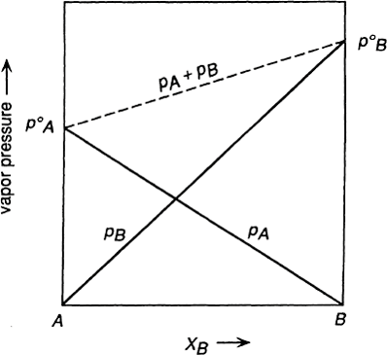
248 Introduction to the Thermodynamics of Materials
Eqs. (9.5) and (9.6) are expressions of Raoult’s law, which states that the vapor pressure exerted by a component i in a solution is equal to the product of the mole fraction of i in the solution and the saturated vapor pressure of pure liquid i at the temperature of the solution. Raoult’s law is shown in Fig. 9.1; the components of a solution which obeys Raoult’s law are said to exhibit Raoultian behavior.
The derivations of Eqs. (9.3) and (9.4) required the assumption that the intrinsic rates of evaporation of A and B be independent of the composition of the solution. This requires that the magnitudes of the A–A, B–B, and A–B bond energies in the solution be identical, in which case the depth of the potential energy well of an atom at the surface is independent of the types of atoms which it has as nearest neighbors.
Consider the case in which the A–B bond energy is considerably more negative than the A–A and B–B bond energies, and consider a solution of A in B which is sufficiently dilute that every A atom on the surface of the liquid is surrounded only by B atoms. In this case the A atoms at the surface are each located in a deeper potential energy well than are the A atoms at the surface of pure A. Thus, in order to leave the surface and enter the vapor phase, the A atoms have to be lifted from deeper wells, and, consequently, the
intrinsic rate of evaporation of A is decreased from r_{e(A)} to the condensed solution and the vapor phase occurs when
.
Equilibrium between
(9.7)
Figure 9.1 The vapor pressures exerted by the components of a binary Raoultian solution.

Slide 5
The Behavior of Solutions 249
Combination of Eqs. (9.1) and (9.7) then gives
(9.8)
and as
can be written as
, p_{A} in Eq. (9.8) is a smaller quantity than pA in Eq. (9.5). Eq. (9.8)
(9.9)
As the mole fraction of A in the A–B solution is increased, the probability that all of the A atoms on the surface of the liquid are surrounded only by B atoms decreases. The occurrence of a pair of neighboring A atoms on the surface decreases the depth of the
potential wells in which they are located and hence increases the value of . Beyond
some critical mole fraction of A varies with composition, and, hence, Eq. (9.9) is no longer obeyed by A in solution. Consequently, Eq. (9.9) is obeyed only over an initial range of concentration of A in B, the extent of which is dependent on the temperature of the solution and on the relative magnitudes of the A–A, B–B, and A–B bond energies. A similar consideration of dilute solutions of B in A gives
(9.10)
which is obeyed over an initial range of concentration. Eqs. (9.9) and (9.10) are known as Henry’s law, and, in the ranges of composition in which Henry’s law is obeyed, the solutes are said to exhibit Henrian behavior. If the A–B bond energy is more negative than
the A–A and B–B bond energies, then, as , the Henry’s law line lies below the Raoult’s law line. Conversely, if the A–B bond energy is less negative than the A–B and B–B bond energies, the solute atom, surrounded only by solvent atoms, is located in a shallower potential energy well than that which occurs in the pure solute. In this case

Slide 6
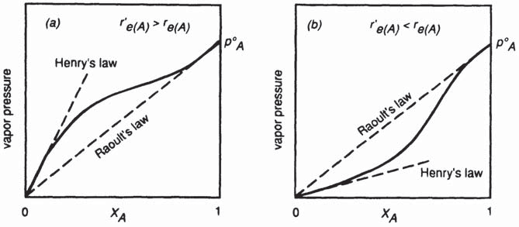
250 Introduction to the Thermodynamics of Materials
, and hence, the Henry’s law line lies above the Raoult’s law line.
Henrian behavior of the solute is illustrated in Figs. 9.2a and b.
Figure 9.2 (a) The vapor pressure of a component of a binary solution which exhibits positive deviation from Raoultian behavior, (b) The vapor pressure of a component of a binary so- lution which exhibits negative deviation from Raoultian behavior.
9.3 THE THERMODYNAMIC ACTIVITY OF A COMPONENT IN SOLUTION
The thermodynamic activity of a component in any state at the temperature T is formally defined as being the ratio of the fugacity of the substance in that state to its fugacity in its standard state, i.e., for the species or substance i,
(9.11)

Slide 7
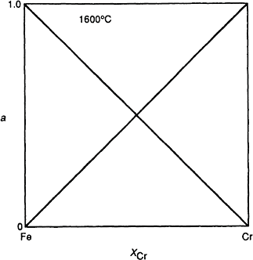
The Behavior of Solutions 251
In a condensed solution, f_{i} is the fugacity of the component i in the solution at the
temperature T, and is the fugacity of pure i (the standard state) at the temperature T. If the vapor in equilibrium with the condensed solution is ideal, then f_{i}=p_{i}, in which case
(9.12)
i.e., the activity of i in a solution, with respect to pure i, is the ratio of the partial pressure of i exerted by the solution to the saturated vapor pressure of pure i at the same temperature. If the component i exhibits Raoultian behavior, then Eqs. (9.5) and (9.12) give
(9.13)
which is thus an alternative expression of Raoult's law. Fig. 9.3 shows Raoultian behavior in a binary solution in terms of the activities of the two components. The definition of activity thus normalizes the vapor pressure-composition relationship with respect to the saturated vapor pressure exerted in the standard state.
Figure 9.3 Activities in the binary system iron-chromium at 1600°C.

Slide 8
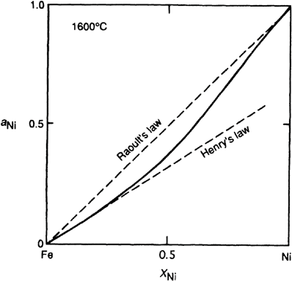
252 Introduction to the Thermodynamics of Materials
Figure 9.4 The activity of nickel in the system iron-nickel at 1600°C.
Similarly, over the composition range in which Henry’s law is obeyed by the solute i,
Eqs. (9.9) and (9.12) give
(9.14)
which is an alternative expression of Henry’s law. Henrian behavior, in terms of the activity of a component of a binary solution, is shown in Fig. 9.4.
9.4 THE GIBBS-DUHEM EQUATION
It is frequently found that the extensive thermodynamic properties of only one component of a binary (or multicomponent) solution are amenable to experimental measurement. In such cases the corresponding properties of the other component can be obtained from a general relationship between the values of the properties of both components. This

Slide 9
The Behavior of Solutions 253
relationship, which is known as the Gibbs-Duhem relationship, is introduced in this section, and some of its applications are discussed in Sec. 9.8.
The value of an extensive thermodynamic property of a solution is a function of the temperature, the pressure, and the numbers of moles of the components of the solution; i.e., if Q is an extensive molar property then
Thus, at constant T and P the variation of Q with the composition of the solution is given as
(9.15)
In Chap. 8 the partial molar value of an extensive property of a component was defined as
in which case Eq. (9.15) can be written as
(9.16)
Also in Chap. 8 it was seen that is the increase in the value of Q′ for the mixture or solution when 1 mole of i is added to a large quantity of the solution at constant T and P. (The stipulation that the quantity of solution be large is necessitated by the requirement that the addition of 1 mole of i to the solution should not cause a measurable change in its
composition.) Thus, if is the value of Q per mole of i in the solution, then the value of
Q′ for the solution itself is
(9.17)
differentiation of which gives
(9.18)

Slide 10
254 Introduction to the Thermodynamics of Materials
Comparison of Eqs. (9.16) and (9.18) shows that, at constant T and P,
or, generally,
(9.19)
Division of Eq. (9.19) by n, the total number of moles of all the components of the solution, gives
(9.20)
Eqs. (9.19) and (9.20) are equivalent expressions of the Gibbs-Duhem equation.
9.5 THE GIBBS FREE ENERGY OF FORMATION OF A SOLUTION The Molar Gibbs Free Energy of a Solution and the Partial Molar Gibbs
Free Energies of the Components of the Solution
In terms of the Gibbs free energy (as an extensive thermodynamic property), Eq. (9.17), for a binary A–B solution at fixed temperature and pressure, is
(9.21)
where
and
are, respectively, the partial molar Gibbs free energies of A and B in
the solution. Dividing both sides of Eq. (9.21) by n_{A}+n_{B} gives the molar Gibbs free energy of the solution as
(9.22)
and differentiation gives
(9.23)

Slide 11
The Behavior of Solutions 255
However, as the Gibbs-Duhem equation gives becomes
, Eq. (9.23)
(9.24)
or
(9.25)
(
, and hence dX_{A}=–dX_{B}). Multiplication of Eq. (9.25) by X_{B} gives
(9.26)
and addition of Eqs. (9.26) and (9.22) gives
(9.27a)
or
Similarly
(9.27b)
These expressions relate the dependence on composition of the partial molar Gibbs free ener- gies of the components of a binary solution and the molar Gibbs free energy of the solution.

Slide 12
256 Introduction to the Thermodynamics of Materials
The Change in Gibbs Free Energy Due to the Formation
The pure component i, occurring in a condensed state at the temperature T, exerts an
equilibrium vapor pressure , and when occurring in a condensed solution at the temperature T, it exerts a lower equilibrium pressure p_{i}. Consider the following
isothermal three-step process:
The evaporation of 1 mole of pure condensed i to vapor i at the pressure
A decrease in the pressure of 1 mole of vapor i from to p_{i}
The condensation of 1 mole of vapor i from the pressure p_{i} to the condensed solution
The difference between the molar Gibbs free energy of i in the solution and the molar Gibbs free energy of pure i is given by the sum OG_{(a)}+OG_{(b)}+OG_{(c)}. However, as steps
(a) and (c) are processes conducted at equilibrium, OG_{(a)} and OG_{(c)} are both zero. The
overall change in Gibbs free energy which accompanies the isothermal three-step process is thus OG_{(b)} which, from Eq. (8.9), is given as
and, from Eq. (9.12), this can be written as
But G_{i} (in solution) is simply the partial molar Gibbs free energy of i in the solution, and G_{i} (pure) is the molar Gibbs free energy of pure i. The difference between the two is the change in the Gibbs free energy accompanying the solution of 1 mole of i in the solution.
This quantity is designated as , the partial molar Gibbs free energy of the solution of i. Thus
(9.28)
If n_{A} moles of A and n_{B} moles of B are mixed to form a solution at constant temperature and pressure,
and

Slide 13
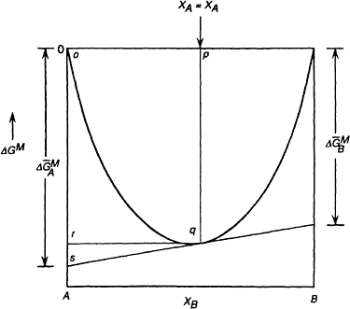
The Behavior of Solutions 257
The change in the Gibbs free energy caused by the mixing process, OG′^{M}, referred to as the integral Gibbs free energy of mixing, is the difference between these quantities, i.e.,
Figure 9.5 The variation, with composition, of the molar Gibbs free energy of formation of a binary solution.
Substitution from Eq. (9.28) gives
(9.29)
or
(9.30)

Slide 14
258 Introduction to the Thermodynamics of Materials
For 1 mole of solution, Eqs. (9.29) and (9.30), respectively, become
(9.31)
and
(9.32)
The variation of OG^{M} with composition, given by Eq. (9.32), is shown in Fig. 9.5.
The Method of Tangential Intercepts
In terms of the solution properties, Eqs. (9.27a) and (9.27b) can be written as
(9.33a)
and
(9.33b)
Consider the composition X_{A} (the point p in Fig. 9.5). At X_{A}
From Eq. (9.33a),

Slide 15
The Behavior of Solutions 259
Similarly, at the composition
.
The method of tangential intercepts can be used to obtain the partial molar values of any extensive property from the variation, with composition, of the integral value of the property.
9.6 THE PROPERTIES OF RAOULTIAN IDEAL SOLUTIONS
The components of a Raoultian ideal solution obey the relation
and hence, for an ideal binary A–B solution, Eq. (9.32) becomes
(9.34)
with
As discussed in Chap. 8, the general thermodynamic relationships between the state properties of a system are applicable to the partial molar properties of the components of a system. Thus, for the species i occurring in a solution,
(9.35)
and, for pure i
(9.36)

Slide 16
260 Introduction to the Thermodynamics of Materials
The Change in Volume Accompanying the Formation of an Ideal Solution
Subtraction of Eq. (9.36) from Eq. (9.35) gives
or
(9.37)
In an ideal solution,
ln X_{i}, and, as X_{i} is not a function of pressure, then
The change in volume due to mixing, OV′^{M}, is the difference between the volumes of the components in the solution and the volumes of the pure components, i.e., for a binary A–B solution containing n_{A} moles of A and n_{B} moles of B,
For an ideal solution , and thus it is seen that the change in volume accompanying an ideal solution is zero, i.e.,
(9.38)
The volume of an ideal solution is thus equal to the sum of the volumes of the pure components. The variation, with composition, of the molar volume of an ideal binary solution is shown in Fig. 9.6. At any composition the values of the partial molar volumes
and are obtained as the intercepts of the tangents to the volume-composition

Slide 17
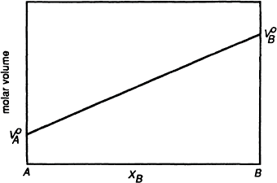
The Behavior of Solutions 261
Figure 9.6 The variation, with composition, of the molar volume of a binary Raoultian solution.
line with the respective axes. As the molar volume of an ideal solution is a linear function of composition, then, trivially, the tangent at any point coincides with the straight line such that
The Heat of Formation of an Ideal Solution
For a component in a solution, the Gibbs-Helmholtz equation, Eq. (5.37), is
(9.39)
and, for the pure component,
(9.40)
where and are, respectively, the partial molar enthalpy of i in the solution and the standard molar enthalpy of i. Subtraction of Eq. (9.40) from Eq. (9.39) gives

Slide 18
262 Introduction to the Thermodynamics of Materials
or
(9.41)
where is the partial molar heat of solution of i.
In an ideal solution substituton of which into Eq. (9.41)
and, as X_{i} is not a function of temperature, it is seen that, for a component of an ideal solution,
or
(9.42)
The heat of formation of a solution (or the heat of mixing of the components) is the difference between the enthalpies of the components in solution and the enthalpies of the pure components before mixing. Thus for a mixture of n_{A} moles of A and n_{B} moles of B
For an ideal solution solution, O^{HM,id}, is zero, i.e.,
,
and thus it is seen that the heat of formation of an ideal
(9.43)

Slide 19
The Behavior of Solutions 263
The Entropy of Formation of an Ideal Solution
The fundamental equation, Eq. (5.25), gives
Thus, for the formation of a solution
For an ideal solution
and hence
(9.44)
Eq. (9.44) shows that the entropy of formation of an ideal binary solution is independent of temperature.
Eq. (4.18) gave, for the mixing of N_{A} particles of A with N_{B} particles of B,
(4.17)
Application of Stirling’s theorem* gives
*Stirling’s theorem is and thus ln large values of m, can be written as ln m!=m ln m–m.
ln (2 vm)+m ln m–m, which, for

Slide 20
264 Introduction to the Thermodynamics of Materials
Now,
and, similarly,
Also
and
where N_{o} is Avogadro’s number. Thus
But, as Boltzmann’s constant (k) times Avogadro’s number (N_{O}) equals the gas constant
(R),

Slide 21
The Behavior of Solutions 265
Division by n_{A}+n_{B}, the total number of moles, gives
(9.45)
which is identical with Eq. (9.44). Thus the increase in entropy accompanying the formation of an ideal solution is a measure of the increase in the number of spatial configurations which become available to the system as a result of the mixing process. This is dependent only on the numbers of moles of the components in the solution and is
independent of temperature. The variation of OS^{M,id} with composition in a binary A–B
solution is shown in Fig. 9.7. As
it is seen that, in an ideal solution
For any solution
and, for an ideal solution, as OH^{M,id}=0, then

Slide 22
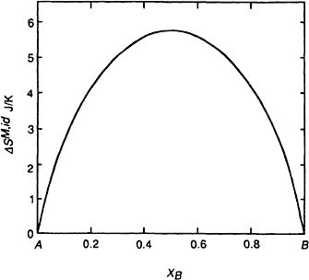
266 Introduction to the Thermodynamics of Materials
Figure 9.7 The variation, with composition, of the molar entropy of formation of a binary Raoultian solution.
9.7 NONIDEAL SOLUTIONS
A nonideal solution is one in which the activities of the components are not equal to their mole fractions. However, in view of the convenience of the concept of activity and the simplicity of Raoult’s law, it is convenient to define an additional thermodynamic function called the activity coefficient, μ. The activity coefficient of a component of a solution is defined as the ratio of the activity of the component to its mole fraction, i.e., for the component i,
(9.46)
The value of μ_{i} can be greater or less than unity (μ_{i}=1 gives ideal Raoultian behavior). If μ_{i}>1, then the component i is said to exhibit a positive deviation from Raoultian ideal behavior, and, if μ_{i}<1, then the component i is said to exhibit a negative deviation from Raoult’s law. Fig. 9.8 shows the variation of a, with X_{i} for a component i which exhibits
negative deviations, and Fig. 9.9 shows a system which exhibits positive deviations. The corresponding variations of μ_{i} are shown in Figs. 9.10 and 9.11.

